Slide 1
InfiniBand

Slide 2
Overview
What is InfiniBand
InfiniBand Architecture

Slide 3
IBA
The InfiniBand Architecture (IBA) is a new industry-standard architecture for server I/O and inter-server communication.
Developed by InfiniBand Trade Association (IBTA).
It defines a switch-based, point-to-point interconnection network that enables
High-speed
Low-latency
communication between connected devices.

Slide 4
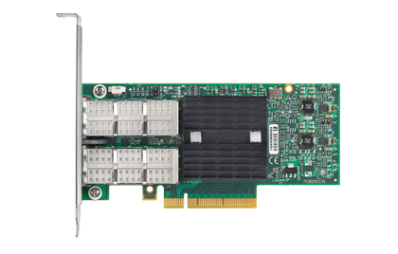
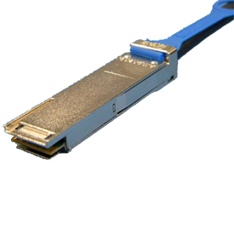

InfiniBand Devices
Adapter Card
Cable
Switch

Slide 5
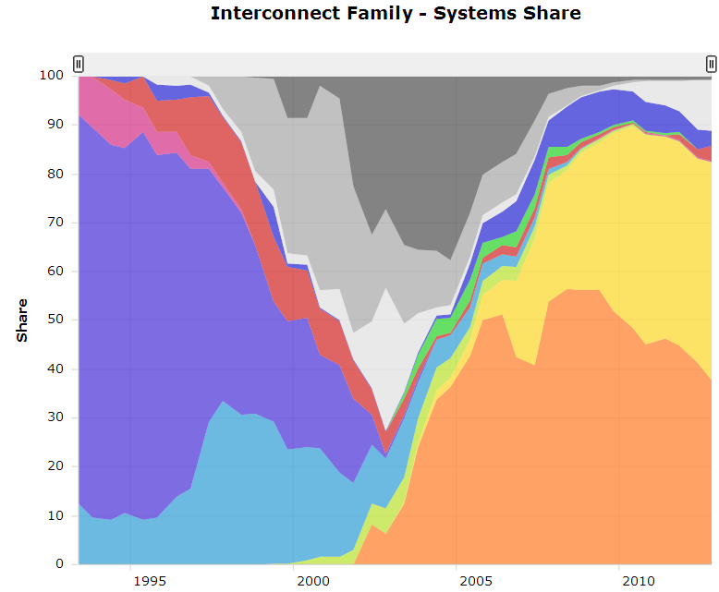
Usage
InfiniBand is commonly used in high performance computing (HPC).
InfiniBand 44.80%
Gigabit Ethernet
37.80%

Slide 6
InfiniBand VS. Ethernet
 | Ethernet | InfiniBand
Commonly used in what kinds of network | Local area network(LAN) or wide area network(WAN) | Interprocess communication (IPC) network
Transmission medium | Copper/optical | Copper/optical
Bandwidth | 1Gb/10Gb | 2.5Gb~120Gb
Latency | High | Low
Popularity | High | Low
Cost | Low | High

Slide 7
InfiniBand Architecture
The IBA Subnet
Communication Service
Communication Model
Subnet Management

Slide 8
IBA Subnet Overview
IBA subnet is the smallest complete IBA unit.
Usually used for system area network.
Element of a subnet
Endnodes
Links
Channel Adapters(CAs)
Connect end nodes to links
Switches
Subnet manager

Slide 9
IBA Subnet

Slide 10
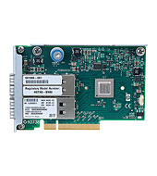
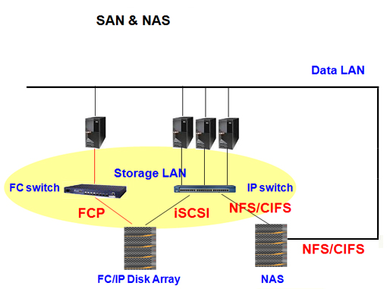
Endnodes
IBA endnodes are the ultimate sources and sinks of communication in IBA.
They may be host systems or devices.
Ex. network adapters, storage subsystems, etc.

Slide 11
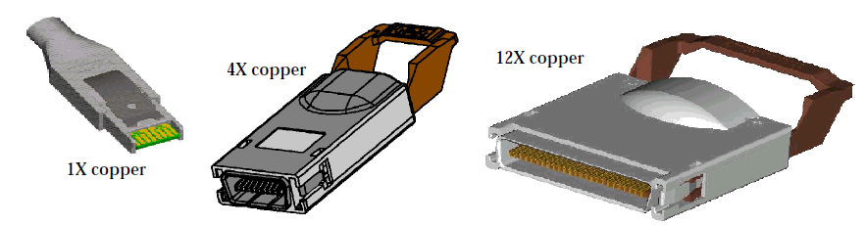
Links
IBA links are bidirectional point-to-point communication channels, and may be either copper and optical fibre.
Link widths are 1X, 4X, and 12X.

Slide 12
Channel Adapter
Channel Adapter (CA) is the interface between an endnode and a link
There are two types of channel adapters
Host channel adapter(HCA)
For inter-server communication
Has a collection of features that are defined to be available to host programs, defined by verbs
Target channel adapter(TCA)
For server IO communication
No defined software interface

Slide 13
Switches
IBA switches route messages from their source to their destination based on routing tables
Support multicast and multiple virtual lanes
Switch size denotes the number of ports
The maximum switch size supported is one with 256 ports
The addressing used by switched
Local Identifiers, or LIDs allows 48K end nodes on a single subnet
The 64K LID address space is reserved for multicast addresses
Routing between different subnets is done on the basis of a Global Identifier (GID) that is 128 bits long

Slide 14
Addressing
LIDs
Local Identifiers, 16 bits
Used within a subnet by switch for routing
GUIDs (For each HCA)
Global Unique Identifier
64 EUI-64 IEEE-defined identifiers for elements in a subnet
GIDs
Global IDs, 128 bits
Used for routing across subnets

Slide 15
Infiniband Components
HCA
Switch
Router
Gateway (Infiniband to Ethernet)

Slide 16
HCA
GUID (Global Unique Identifier) = 64 bits (Like Ethernet Mac Address)
Assigned by IB vendor
Persistent (Reboots)
Each switch will have one GUID
Chassis switch will allow to combine multiple GUID into one

Slide 17
LID (Local Identifier)
16 bit
By Subnet Manager
Not persistent
LID RANGE
0x0000 = Reserved
0x0001 <-> 0xBFFF Unicast
0xc001 <-> 0xFFFE Multicast
0xFFFF = Reserved

Slide 18
GID (Global Identifier)
128 bit field in Global Routing Header used to route packets between different IB subnets
Port ID Guid + Subent Id (Link Local)

Slide 19
Subnet Manager
Each node will have a agent
Agent always in touch with SM
Management Datagram (Standard Message format for Agent-Manager communication)
Subnet Packet Manager ( Manager-Agent Communication)
Each Communication medium will have virtual lanes
VL-15 (Traffic to SM)
VL- (0-7) used for data traffic
OPED (InfiniBand Driver) Open Fabrics Enterprise Distribution

Slide 20
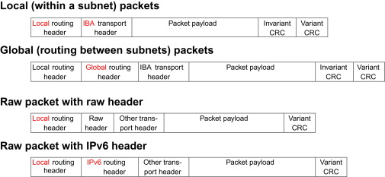

Slide 21
LRH = 8 bytes
GRH = 40 bytes
IBH = 12 bytes
Payload = 4096 bytes
I-CRC = 4 bytes
V-CRC = 2 bytes

Slide 22
InfiniBand Architecture
The IBA Subnet
Communication Service
Communication Model
Subnet Management

Slide 23
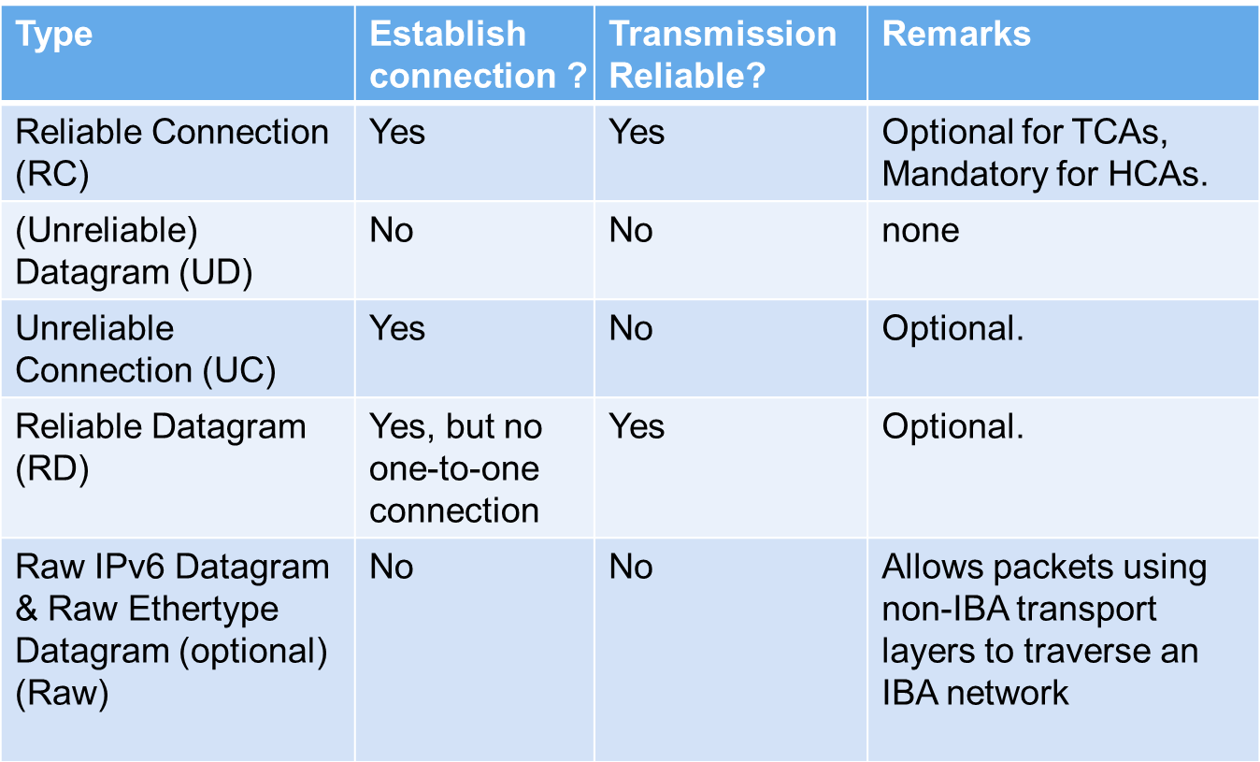
Communication Service Types

Slide 24
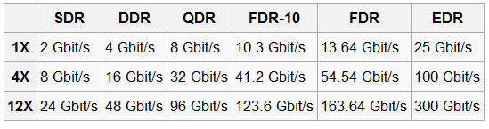
Data Rate
Effective theoretical throughput

Slide 25
InfiniBand Architecture
The IBA Subnet
Communication Service
Communication Model
Subnet Management

Slide 26
Queue-Based Model
Channel adapters communicate using Work Queues of three types:
Queue Pair(QP) consists of
Send queue
Receive queue
Work Queue Request (WQR) contains the communication instruction
It would be submitted to QP.
Completion Queues (CQs) use Completion Queue Entries (CQEs) to report the completion of the communication

Slide 27
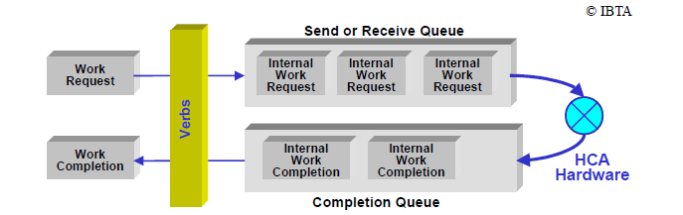
Queue-Based Mode

Slide 28

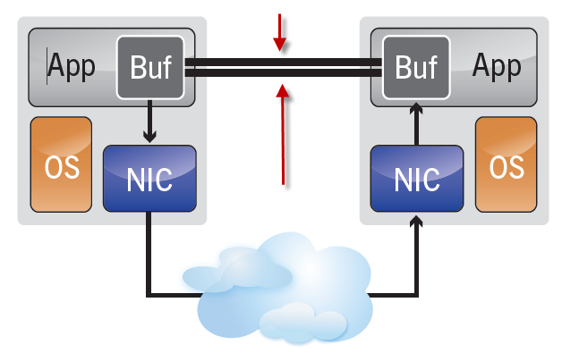
Communication Semantics
Two types of communication semantics
Channel semantics
With traditional send/receive operations.
Memory semantics
With RDMA operations.

Slide 29
Send and Receive
Process
Remote Process
WQE
CQ
CQ
QP
QP
Transport Engine
Transport Engine
Send Recv
Send Recv
Channel
Adapter
Channel
Adapter
Port
Port
Fabric

Slide 30
Send and Receive
Process
Remote Process
WQE
CQ
CQ
QP
QP
Transport Engine
Transport Engine
WQE
Send Recv
Send Recv
Channel
Adapter
Channel
Adapter
Port
Port
Fabric

Slide 31
Send and Receive
Process
Remote Process
CQ
CQ
QP
QP
Transport Engine
Transport Engine
WQE
WQE
Send Recv
Send Recv
Data packet
Channel
Adapter
Channel
Adapter
Port
Port
Fabric

Slide 32
Send and Receive
Complete
Process
Remote Process
CQ
CQ
QP
CQE
QP
CQE
Transport Engine
Transport Engine
Send Recv
Send Recv
Channel
Adapter
Channel
Adapter
Port
Port
Fabric

Slide 33
RDMA Read / Write
Process
Remote Process
Target Buffer
CQ
CQ
QP
QP
Transport Engine
Transport Engine
Send Recv
Send Recv
Channel
Adapter
Channel
Adapter
Port
Port
Fabric

Slide 34
RDMA Read / Write
Process
Remote Process
Target Buffer
WQE
CQ
CQ
QP
QP
Transport Engine
Transport Engine
Send Recv
Send Recv
Channel
Adapter
Channel
Adapter
Port
Port
Fabric

Slide 35
RDMA Read / Write
Process
Remote Process
Target Buffer
Read / Write
CQ
CQ
QP
QP
Transport Engine
Transport Engine
WQE
Send Recv
Send Recv
Data packet
Channel
Adapter
Channel
Adapter
Port
Port
Fabric

Slide 36
RDMA Read / Write
Complete
Process
Remote Process
Target Buffer
CQ
CQ
QP
CQE
QP
Transport Engine
Transport Engine
Send Recv
Send Recv
Channel
Adapter
Channel
Adapter
Port
Port
Fabric

